Slide 1

Austin DemoCamp
Welcome! Thanks for coming! Enjoy the tacos! Sorry for the lack of pizza!
Agenda
  Chris Aniszczyk, What's new in Plug-in Development?
  James E. Ervin, Groovy Eclipse and Groovy Monkey
  Donald Smith, Intellectual Property Law For Dummies
  Tom Hochstein, Freescale's Multicore Tools
  Pierre Carlson, IBM Lotus Expeditor
  Thomas Watson, What's coming in OSGi r4.2?
Austin Eclipse Regional Community
  URL: http://wiki.eclipse.org/Regional_Communities/US/Austin
  Mailing List: https://dev.eclipse.org/mailman/listinfo/austin-ec
Eclipse Foundation, Inc.
What’s new for PDE in Ganymede? | © 2008 by Chris Aniszczyk; made available under the EPL v1.0

Slide 2
What’s new in Plug-in Development?
“In PDE we do tooling, but our business is people”
Chris Aniszczyk <zx@code9.com>
Principal Consultant at Code 9
PDE Lead
© 2008 by Chris Aniszczyk; made available under Creative Commons Att. Nc Nd 2.5 license
Eclipse Foundation, Inc.
What’s new for PDE in Ganymede? | © 2008 by Chris Aniszczyk; made available under Creative Commons Att. Nc Nd 2.5
Notes:
Note: Mention that this is focused on plug-in development, not building plug-ins

Slide 3
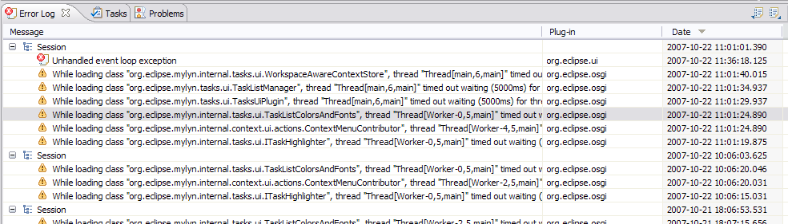
Error Log Enhancements
More than meets the eye… browse launch configuration logs...
Group log entries by
  Session
  Plug-in
Eclipse Foundation, Inc.
What’s new for PDE in Ganymede? | © 2008 by Chris Aniszczyk; made available under the EPL v1.0

Slide 4
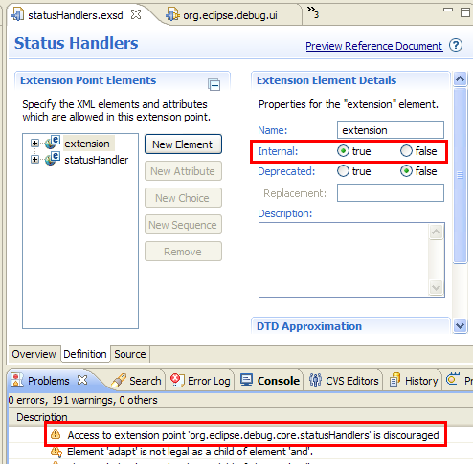
Internal Extension Points
Extension points can be marked as internal now, similar to how you mark packages internal
What’s new for PDE in Ganymede? | © 2008 by Chris Aniszczyk; made available under the EPL v1.0

Slide 5
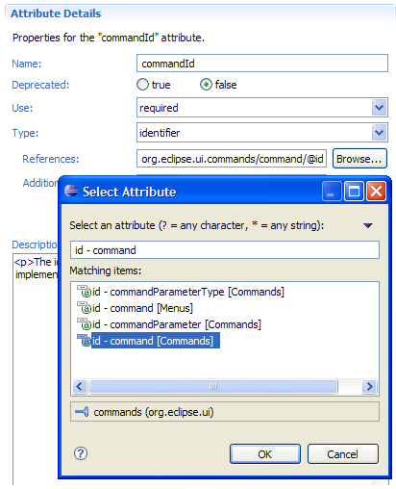
Schema Identifiers
A new type was introduced in extension points: identifier
Identifiers allow you to reference other extensions
e.g., perspective extensions refer to a perspective id that is defined in another extension point
What’s new for PDE in Ganymede? | © 2008 by Chris Aniszczyk; made available under the EPL v1.0

Slide 6
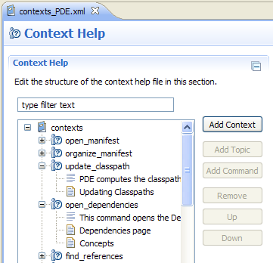
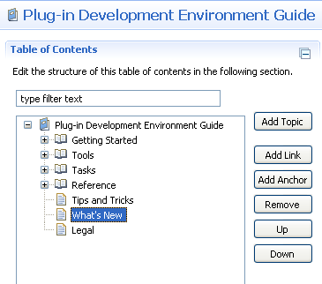
New User Assistance Editors
Table of Contents Editor
Context Help Editor
What’s new for PDE in Ganymede? | © 2008 by Chris Aniszczyk; made available under the EPL v1.0

Slide 7
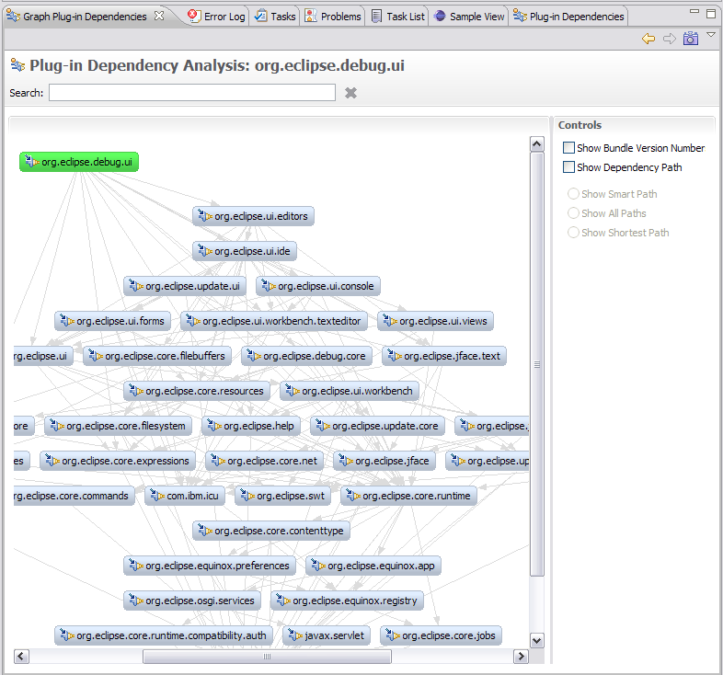
Graph Plug-in Dependencies View (incubator)
PDE Incubator Project
Visualize your dependencies
Pictures are worth a thousand words
* http://www.eclipse.org/pde/incubator/dependency-visualization/
Eclipse Foundation, Inc.
What’s new for PDE in Ganymede? | © 2008 by Chris Aniszczyk; made available under the EPL v1.0

Slide 8
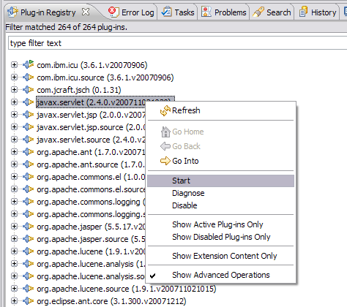
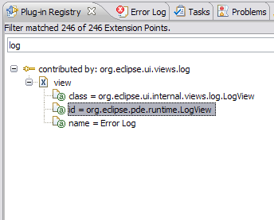
Plug-in Registry View Enhancements
The Plug-in Registry view is your eye into the runtime
Show Advanced Operations
  start/stop bundles
Show Extension Content Only
  quickly browse extensions
Eclipse Foundation, Inc.
What’s new for PDE in Ganymede? | © 2008 by Chris Aniszczyk; made available under the EPL v1.0

Slide 9
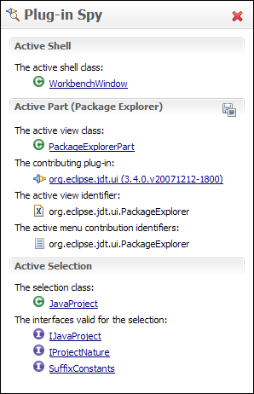
Plug-in Spy (3.4M3)
ALT+SHIFT+F1
Allows you to introspect what you’re looking at…
Hyperlinking
Shows contributing plug-ins
Eclipse Foundation, Inc.
What’s new for PDE in Ganymede? | © 2008 by Chris Aniszczyk; made available under the EPL v1.0

Slide 10
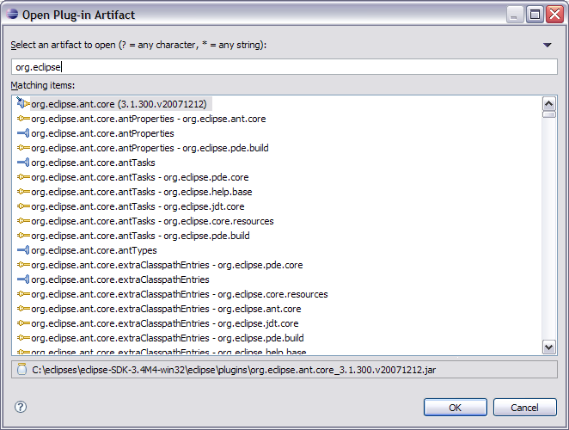
Open Plug-in Artifact (3.4M4)
Ctrl+Shift+A
Quickly browse plug-ins, extensions and extension points
Eclipse Foundation, Inc.
What’s new for PDE in Ganymede? | © 2008 by Chris Aniszczyk; made available under the EPL v1.0

Slide 11
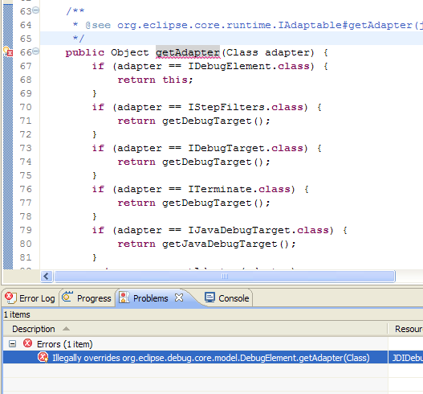
API Tooling (3.4M6)
API tooling will assist developers in API maintenance by reporting…
  API defects such as binary incompatibilities
  incorrect plug-in version numbers
  missing or incorrect @since tags
  usage of non-API code between plug-ins
Eclipse Foundation, Inc.
What’s new for PDE in Ganymede? | © 2008 by Chris Aniszczyk; made available under the EPL v1.0

Slide 12
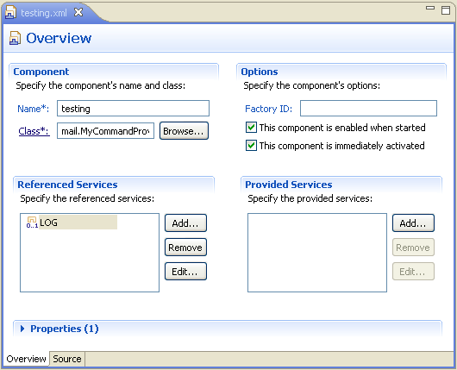
Declarative Services Tooling (3.5M2)
DS Tooling
  Editor
  Validation
  Code Completion
  Sample Templates
Eclipse Foundation, Inc.
What’s new for PDE in Ganymede? | © 2008 by Chris Aniszczyk; made available under the EPL v1.0

Slide 13
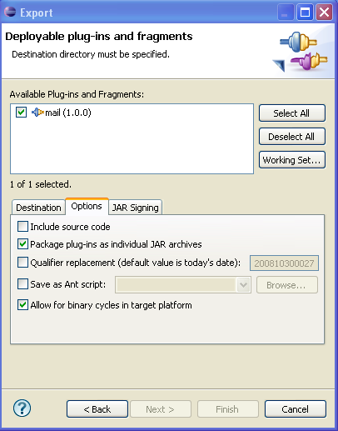
Binary Cycles (3.5M3)
PDE UI and Build supports binary cycles in the target platform
  Note: PDE Build supports this in 3.4
Eclipse Foundation, Inc.
What’s new for PDE in Ganymede? | © 2008 by Chris Aniszczyk; made available under the EPL v1.0

Slide 14
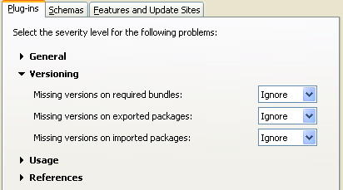
Versioning Checks (3.5M3)
PDE can now help you validate information around versions
Eclipse Foundation, Inc.
What’s new for PDE in Ganymede? | © 2008 by Chris Aniszczyk; made available under the EPL v1.0

Slide 15
Parallel Compliation (3.5M3)
PDE Build now supports parallel compilation
  parallelCompilation=true in your top-level build.properties file
Eclipse Foundation, Inc.
What’s new for PDE in Ganymede? | © 2008 by Chris Aniszczyk; made available under the EPL v1.0

Slide 16
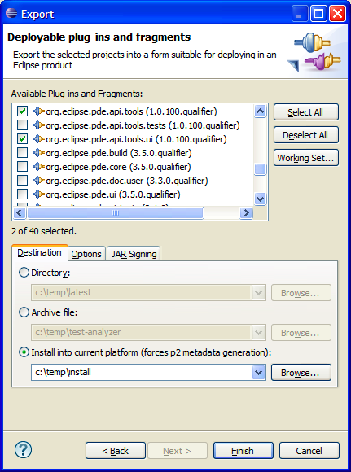
Export to Running Instance (3.5M3)
PDE now supports exporting to the current running platform
Eclipse Foundation, Inc.
What’s new for PDE in Ganymede? | © 2008 by Chris Aniszczyk; made available under the EPL v1.0

Slide 17
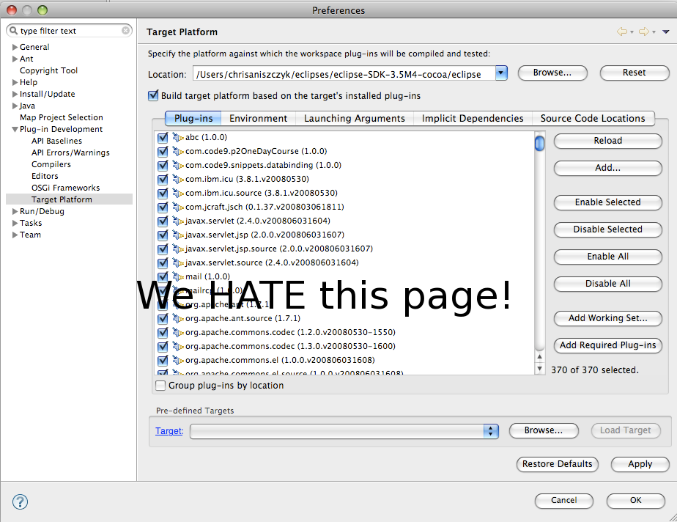
Target Management Improvements (3.4M5)
Eclipse Foundation, Inc.
What’s new for PDE in Ganymede? | © 2008 by Chris Aniszczyk; made available under the EPL v1.0

Slide 18
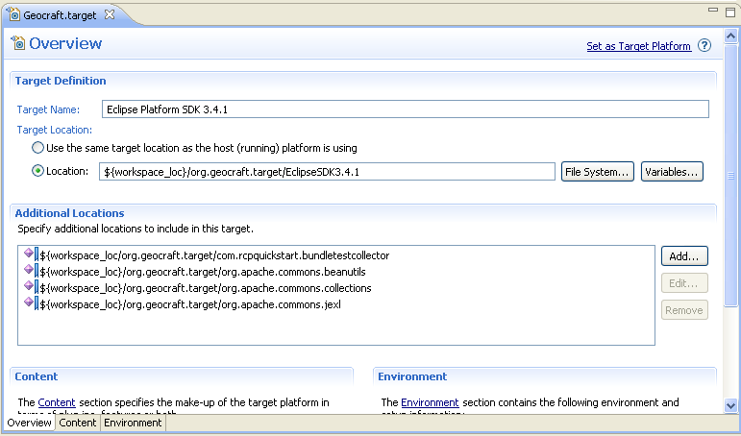
Target Management Improvements (3.5M5)
Target definitions to be used by default
Target itself will be managed by p2
Target can be self-provisioned using p2
Eclipse Foundation, Inc.
What’s new for PDE in Ganymede? | © 2008 by Chris Aniszczyk; made available under the EPL v1.0

Slide 19
Custom Schema Types (3.5M5)
Currently, there are five types of attribute types:
  Resource
  Java
  Identifer
  String
  Boolean
This will allow people to plug-in their own... what does that mean?
Eclipse Foundation, Inc.
What’s new for PDE in Ganymede? | © 2008 by Chris Aniszczyk; made available under the EPL v1.0

Slide 20
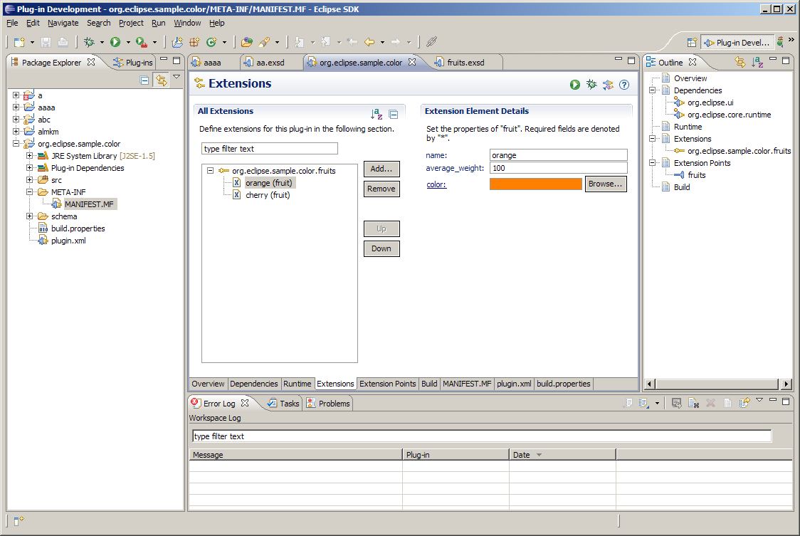

Slide 21
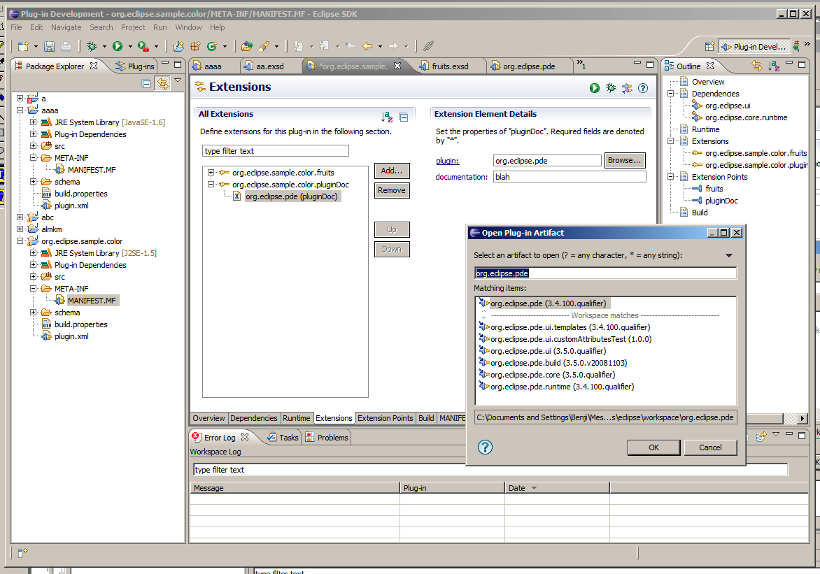

Slide 22

Conclusion
http://www.eclipse.org/pde
Want to contribute?
  PDE Bug Day
  http://wiki.eclipse.org/BugDay
Thank you!
Eclipse Foundation, Inc.
What’s new for PDE in Ganymede? | © 2008 by Chris Aniszczyk; made available under the EPL v1.0

Slide 23
Questions?
Suggestions?
Requests?
Eclipse Foundation, Inc.
What’s new for PDE in Ganymede? | © 2008 by Chris Aniszczyk; made available under the EPL v1.0

